Slide 1
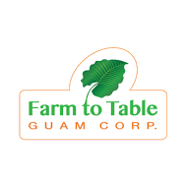
Moving Toward Organic
Prepared by Lindsay Williams
CSA Farm Manager, Farm to Table Guam

Slide 2
What Exactly is Organic?
Produce grown or raised by organic method
- efficient use of resources
- preservation of biodiversity
-ecological balance/natural cycles
-typically limited pesticide use
-ongoing soil health as a primary focus
-certified by third party certifier

Slide 3
“Organic Oreos are not a health food. When Coca-Cola begins selling organic Coke, as it surely will, the company will have struck a blow for the environment perhaps, but not for our health. Most consumers automatically assume that the word "organic" is synonymous with health, but it makes no difference to your insulin metabolism if the high-fructose corn syrup in your soda is organic.”
― Michael Pollan, In Defense of Food: An Eater’s Manifesto

Slide 4
What Does Not Count as Organic?
Say no to Miracle-Gro! Even limited use of certain fertilizers and pesticides can drastically affect plant and soil health
Neglect does not equal organic
GMO seeds typically are avoided by organic growers

Slide 5
National Organic Program and Certification
State-run or accredited private agency evaluates farmers
Those who satisfy standards can market produce as “USDA Certified Organic.” Basically the gold standard for eco-labels
Guam does not currently have organic certification board
Produce can still be marketed as “grown
by organic method”

Slide 6
Organic Certification Requirements
Farmland must be free of prohibited substances for at least 3 years
No GMO products, sewage sludge or irradiation
Usually, organic or untreated seeds
No synthetic pesticides, herbicides or fertilizers
Detailed record keeping
Farm to Table, Guam

Slide 7
So Why Grow Organic?
Long-term land health
Higher selling price and growing demand
Investment in biodiversity of crops and surrounding environment, including community
Philosophy of sustainability
Preservation of heirloom seeds preserves both biodiversity and indigenous cultures
Home garden, Atlanta GA

Slide 8
Pesticides: Why Not?
Produce grown without conventional pesticides is touted as tasting better and as healthier for the consumer.
Over 98% of sprayable insecticides and 95% of herbicides reach a destination other than their target species
Runoff carries pesticides to aquatic areas, groundwater sources, grazing areas and human habitation. Agricultural pesticides were found in 90% of wells sampled in 2007 U.S. Geological Survey.
Active ingredients in conventional pesticides, insecticides, herbicides and fungicides are known to cause adverse reactions in insect, bird, reptile, amphibian and small mammal populations, including beneficial species.
Repeated application increases pest resistance, which can lead to pest rebound and secondary pest outbreaks.
Nitrogen fixation problems in higher plants, poor root development.

Slide 9
Who Grows Organic?
Prior to 1940, all farms were organic by default
According to 2012 U.S. census, 16,525 farms classified as organic. Organic farms sold $5.5 billion in organic products in 2014, an increase of 72% since 2008
Worldwide, organic agricultural land has grown from 27,180,000 acres in 1999 to 107,982,000 in 2014 (Willer, Lernoud 2016)
Organic farms in U.S. vary from a few acres to thousands, but most are smaller than 100 acres, according to USDA data.
Vilicus Farm, Montana, 4700 acres
Heirloom and specialty grains,
oilseeds, pulses

Slide 10
Multiple Organic Approaches
Permaculture Method
Tolstoy Farms, Washington
Permaculture:
Utilizing the land according to its natural features; working with, rather than against, local ecosystems. Focus on relationships between elements, natural patterns.
Care for the earth
Care for the people
Return of the surplus

Slide 11
Agroforestry/Polyculture Technique
Kolea Farm, Pupukea Oahu
Hawaii
Agroforestry:
Tree and shrub crops are grown around or among ground crops and pastureland in multi-story farm systems. Traditional Pacific Islands farm.
Polyculture:
Multiple crops in the same space, mimicking diversity of natural ecosystems

Slide 12
Aquaponics
University of Guam Triton Farm
Aquaponics:
Cultivating plants in water which is also being used for aquaculture (raising fish, snails, prawns). Fish waste is broken down by nitrifying bacteria and utilized as nutrients by the plants. Water is then recirculated into the aquaculture system. Size and complexity of aquaponics systems can vary widely.

Slide 13
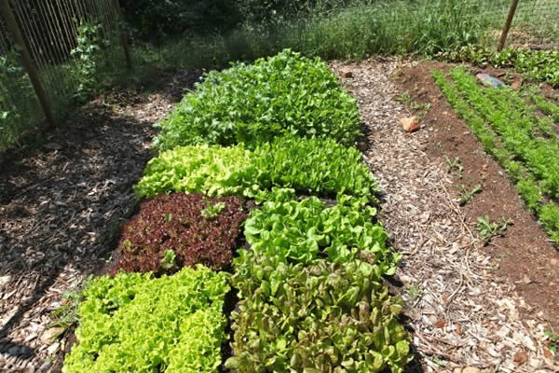
Bio-intensive farming/Hügelkultur
Revive the Roots
Smithfield, Rhode Island
Hügelkultur:
Permaculture technique. Raised beds constructed on top of decaying wood and other biomass materials, mimicking natural process of forest floor decomposition. Ideal for areas with poor or compacted soil. Traditional farming technique in Germany/Eastern Europe.

Slide 14
Organic Farming Methods vs. Conventional Methods
Hand weeding
Mechanical control
Mulches
Cover Crops
Crop Rotation
Dense planting
Intercropping/Companion Planting
Natural Fertilizer Production/Composting
Herbicides
Persistent pesticides
Fallow land
Mono-cropping
Synthetic nitrogen fertilizers

Slide 15
Natural Pest Management
Build up your soil’s biodiversity
Intercropping/companion planting
Utilize beneficial insects, insect traps and barriers
Sanitation: remove infested plant materials and pest habitat, sterilize tools and planters
Use bio-rational and organic pesticides/insecticides/fungicides

Slide 16
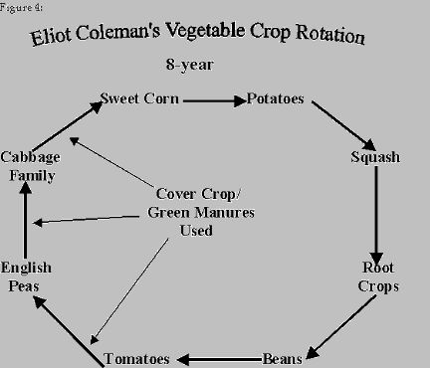

Slide 17
So You Want to Go Organic
First Steps:
What are you already growing?
Where do you get your seeds?
How much space do you have?
What problems do you have?
What techniques do you use?
How do you approach land and water management?
Assess the health of your soil
Create a plan
Keep records

Slide 18
Getting There: Your Resources
University of Guam Cooperative Extension, ANR Unit
(Soil and plant testing, pest diagnostics)
671. 735.2080
Agriculture Development Services
(Seedlings, farmer certification, crop compensation)
671.300.7971
Farm Service Agency
(Direct operating loans, non-insured crop disaster program)
671.300.8550
USDA NRCS, Pacific Islands
(Farm plans, soil and water conservation tactics)
671.735.2111

Slide 19
Organic Education Resources
IFAS Florida Extension Service
www.ifas.ufl.edu
CTAHR Hawaii Extension
www.ctahr.hawaii.edu
Seed Savers Exchange
www.seedsavers.org
University of California Extension, Small and Organic Farm Advisor
www.ccsmallfarms.ucanr.edu
Texas A&M Extension
www.agrilifeextension.tamu.edu

Slide 20
Questions? Comments?
Farm to Table Guam
671.647.0100
www.farmtotableguam.org
Thank you!

